Slide 1
Dijkstra’s Algorithm: Final Project
Aubrey Kopkau, Chloe Robinson, Mark Anjoul, Laray Lopez

Slide 2
Introduction
Creating the Graph ADT
Dijkstra’s Algorithm
Traversal
Implementation in shortestPath()
Demo

Slide 3
Creating The Graph ADT

Slide 4
Adjacency List DS
A
B
C
D
E
B
C
D
A
2
B
9
E
A
D
E
1
4
7
A
D
3
A
B
C
E
C
D
5
B
D

Slide 5
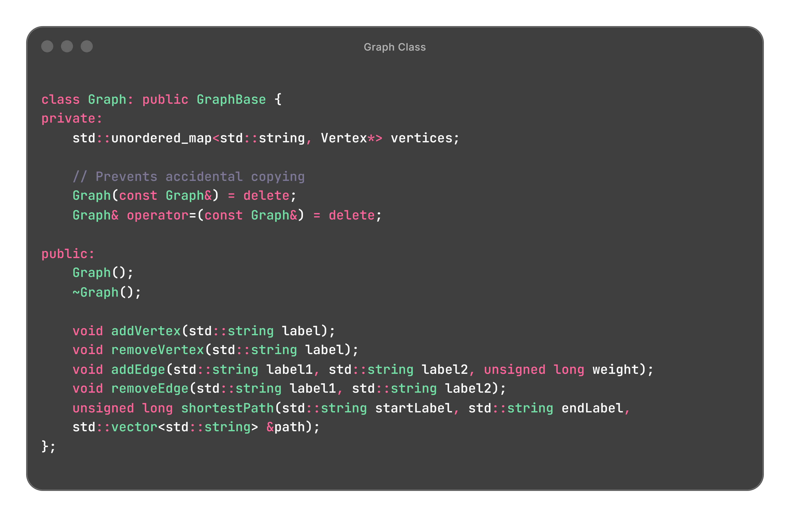
Graph ADT
Vertex
Stores list of adjacent vertices
Edge
Weighted
Not negative

Slide 6
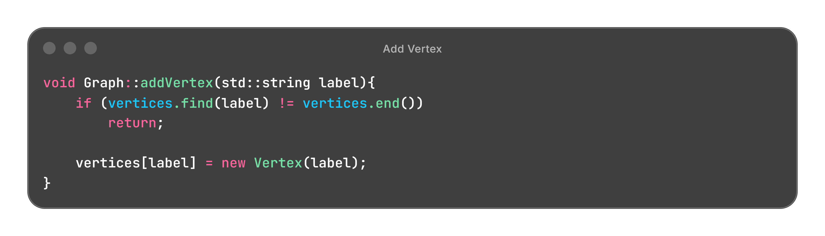
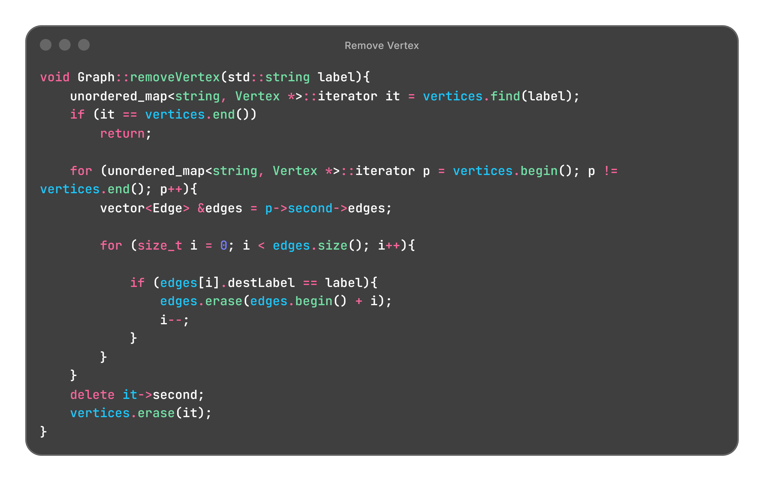
Vertex Addition & Removal
Adding Vertex
Adds vertex if it is not found in the graph
Removing Vertex
Find the vertex to remove
Erase vertex’s adjacent edges
Deletes vertex

Slide 7
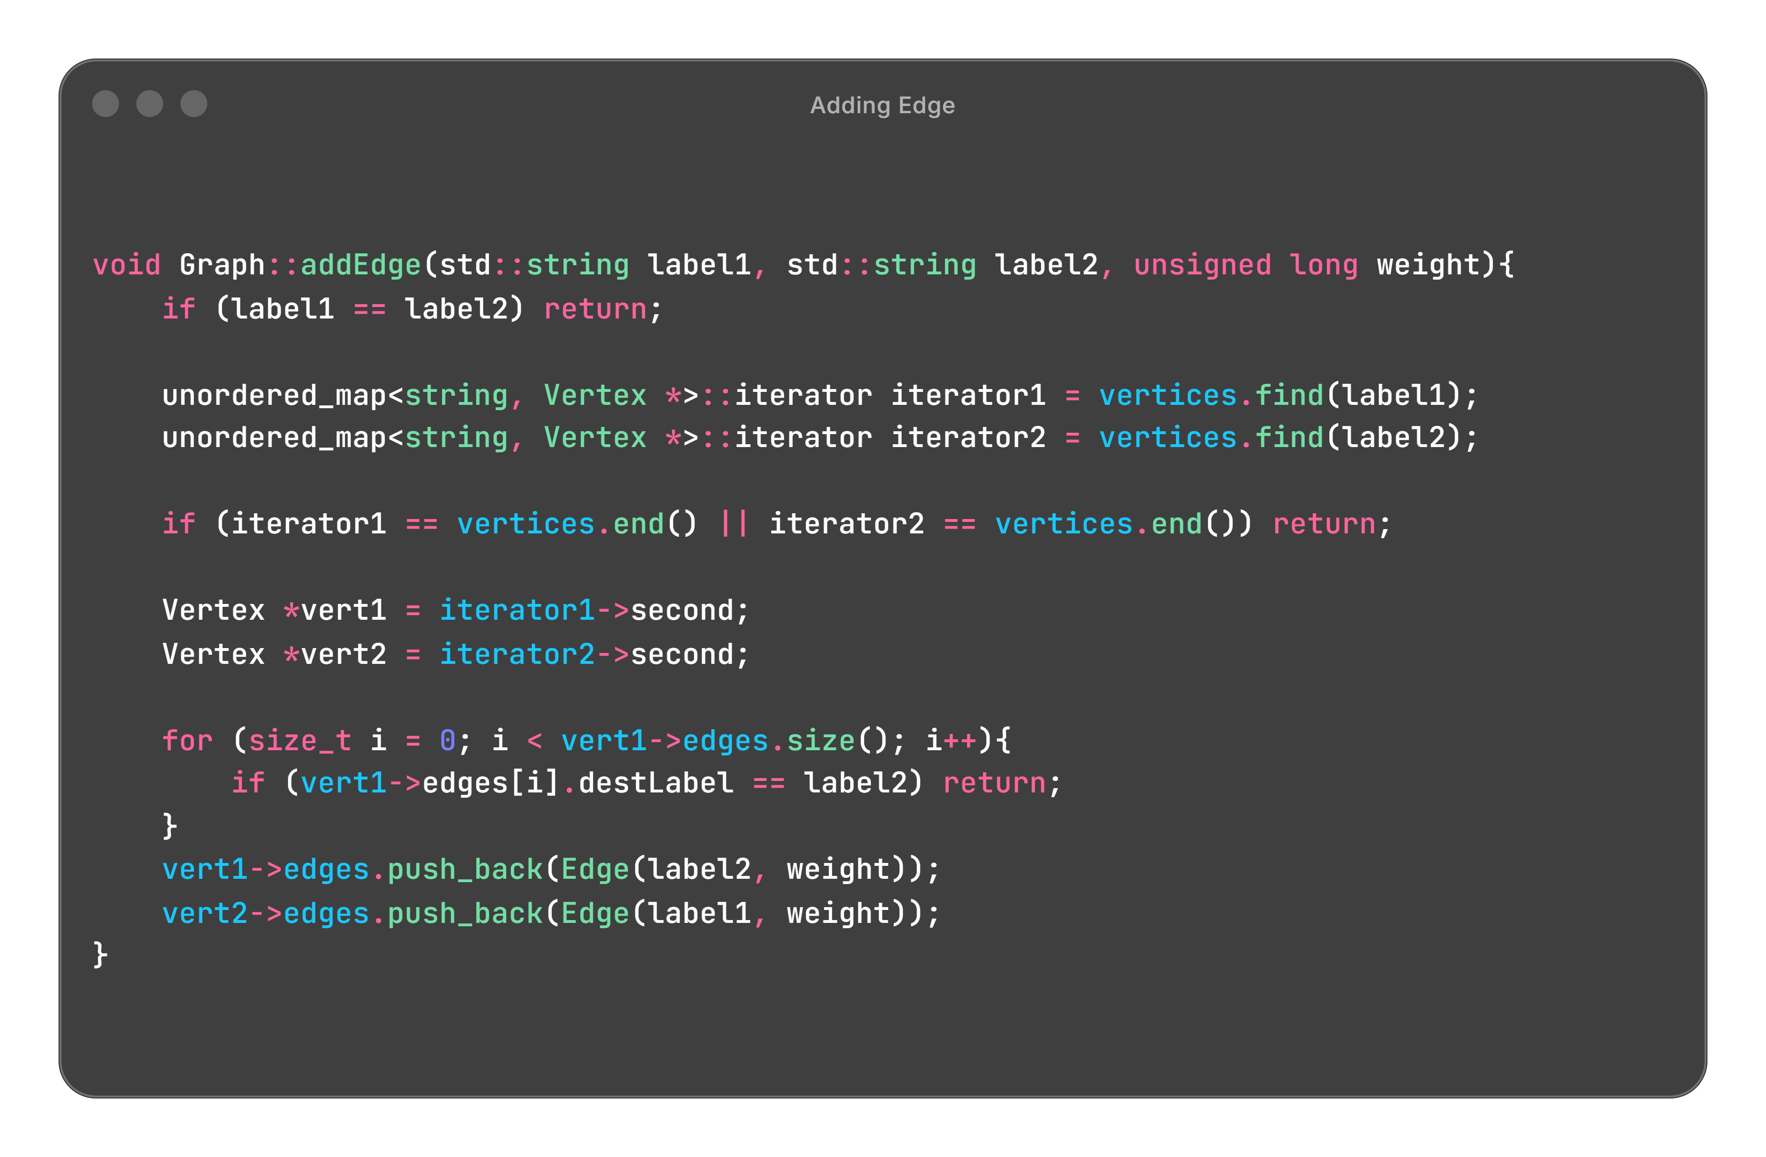
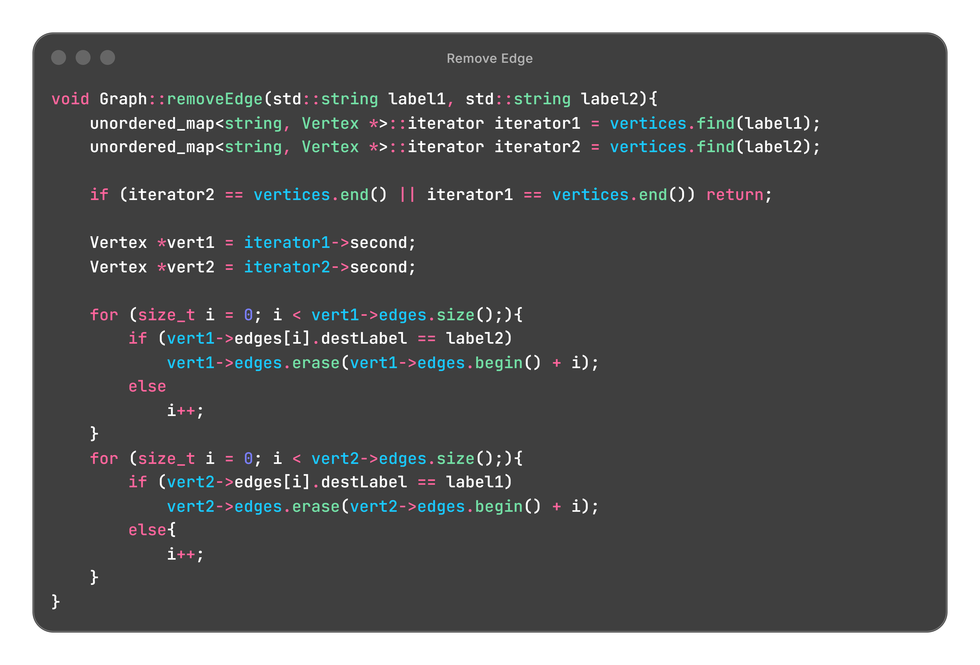
Edge Addition & Removal
Addition:
Validates both vertices and prevents invalid edges.
Ensures the edge does not already exist.
Inserts a bidirectional weighted edge.
Removal:
Validates both vertices before proceeding.
Removes the edge from the first vertex’s adjacency list.
Removes the reverse edge to maintain an undirected graph.

Slide 8
Dijkstra’s Algorithm

Slide 9
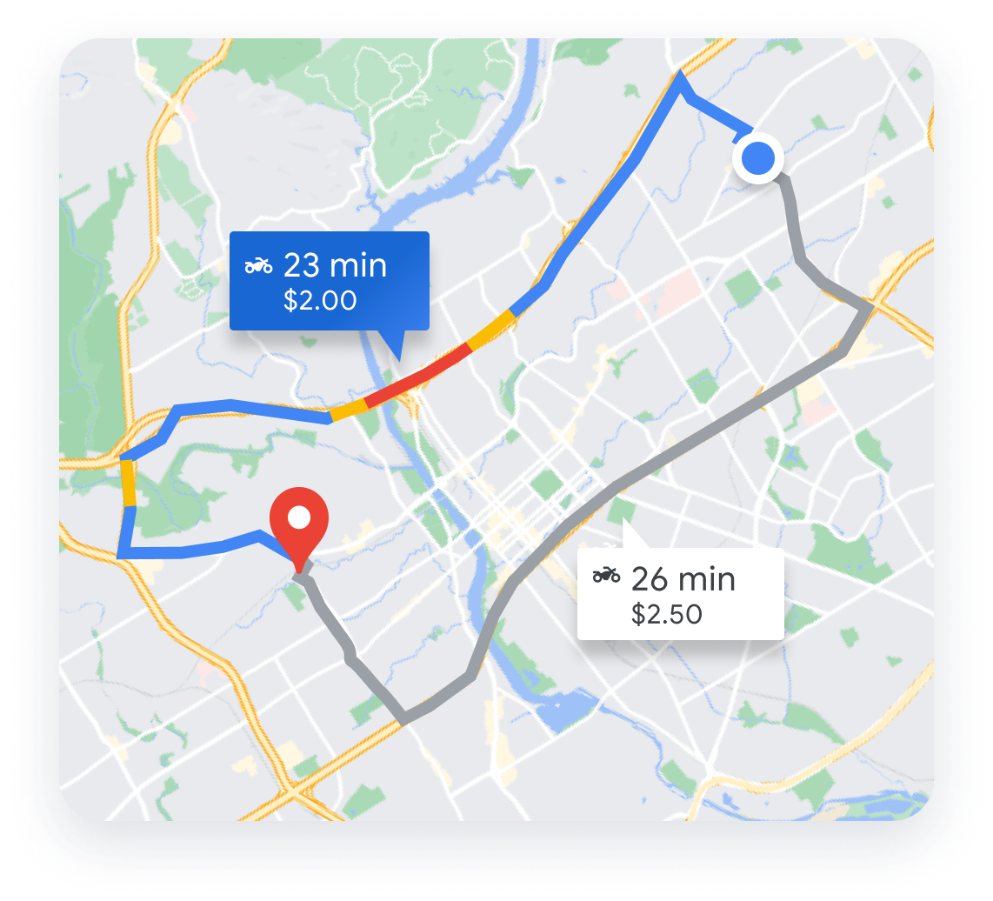
What is Dijkstra’s Algorithm?
An algorithm applied to a weighted graph that finds the smallest path to all vertices.
Real Life Applications:
GPS Navigation (Ex. Google Maps)
Network Routing
Delivery route optimization

Slide 10
General Structure
Initialization:
Mark all nodes as unvisited
Create priority queue to determine next node to visit
Main Loop Body
Select the node u with the smallest weight (dist[u])
Visit u
Relax all edges (u, v)
End Condition
Ends once all nodes have been visited
dist[v] will now hold the shortest distance from source to a vertex v

Slide 11
Traversal

Slide 12
Step 1: Initialization
Start
A
B
Vertex | Distance | Prev
A | 0 | -
B | ∞ | -
C | ∞ | -
D | ∞ | -
E | ∞ | -
2
9
E
1
4
7
3
C
D
5
Priority Queue: A(0)
Visited: {}
Start: A
4

Slide 13
Step 2: Visit A
2
A
B
Vertex | Distance | Prev
A | 0 | -
B | 2 | A
C | 4 | A
D | 1 | A
E | ∞ | -
2
9
E
1
4
7
3
C
D
5
Priority Queue: D(1), B(2), C(4)
Visited: {A}
Next chosen: D
1
4

Slide 14
Step 3: Visit D
2
A
B
Vertex | Distance | Prev
A | 0 | -
B | 2 | A
C | 4 | A
D | 1 | A
E | 4 | D
2
4
9
E
1
4
7
3
C
D
5
Priority Queue: B(2), C(4), E(4)
Visited: {A, D}
Next chosen: B
4
1

Slide 15
Step 3: Visit B
0
2
A
B
Vertex | Distance | Prev
A | 0 | -
B | 2 | A
C | 4 | A
D | 1 | A
E | 4 | D
2
4
9
E
1
4
7
3
C
D
5
Priority Queue: C(4), E(4)
Visited: {A, D, B}
No updates, next chosen: C
4
1

Slide 16
Step 4: Visit C
0
2
A
B
Vertex | Distance | Prev
A | 0 | -
B | 2 | A
C | 4 | A
D | 1 | A
E | 4 | D
2
4
9
E
1
4
7
3
C
D
5
Priority Queue: E(4)
Visited: {A, D, B, C}
No updates, next chosen is E
4
1

Slide 17
Step 5: Visit E
0
2
A
B
Vertex | Distance | Prev
A | 0 | -
B | 2 | A
C | 4 | A
D | 1 | A
E | 4 | D
2
4
9
E
1
4
7
3
C
D
5
Priority Queue: empty
Visited: {A, D, B, C, E}
No updates, algorithm terminates
4
1

Slide 18
Implementation in shortestPath()

Slide 19
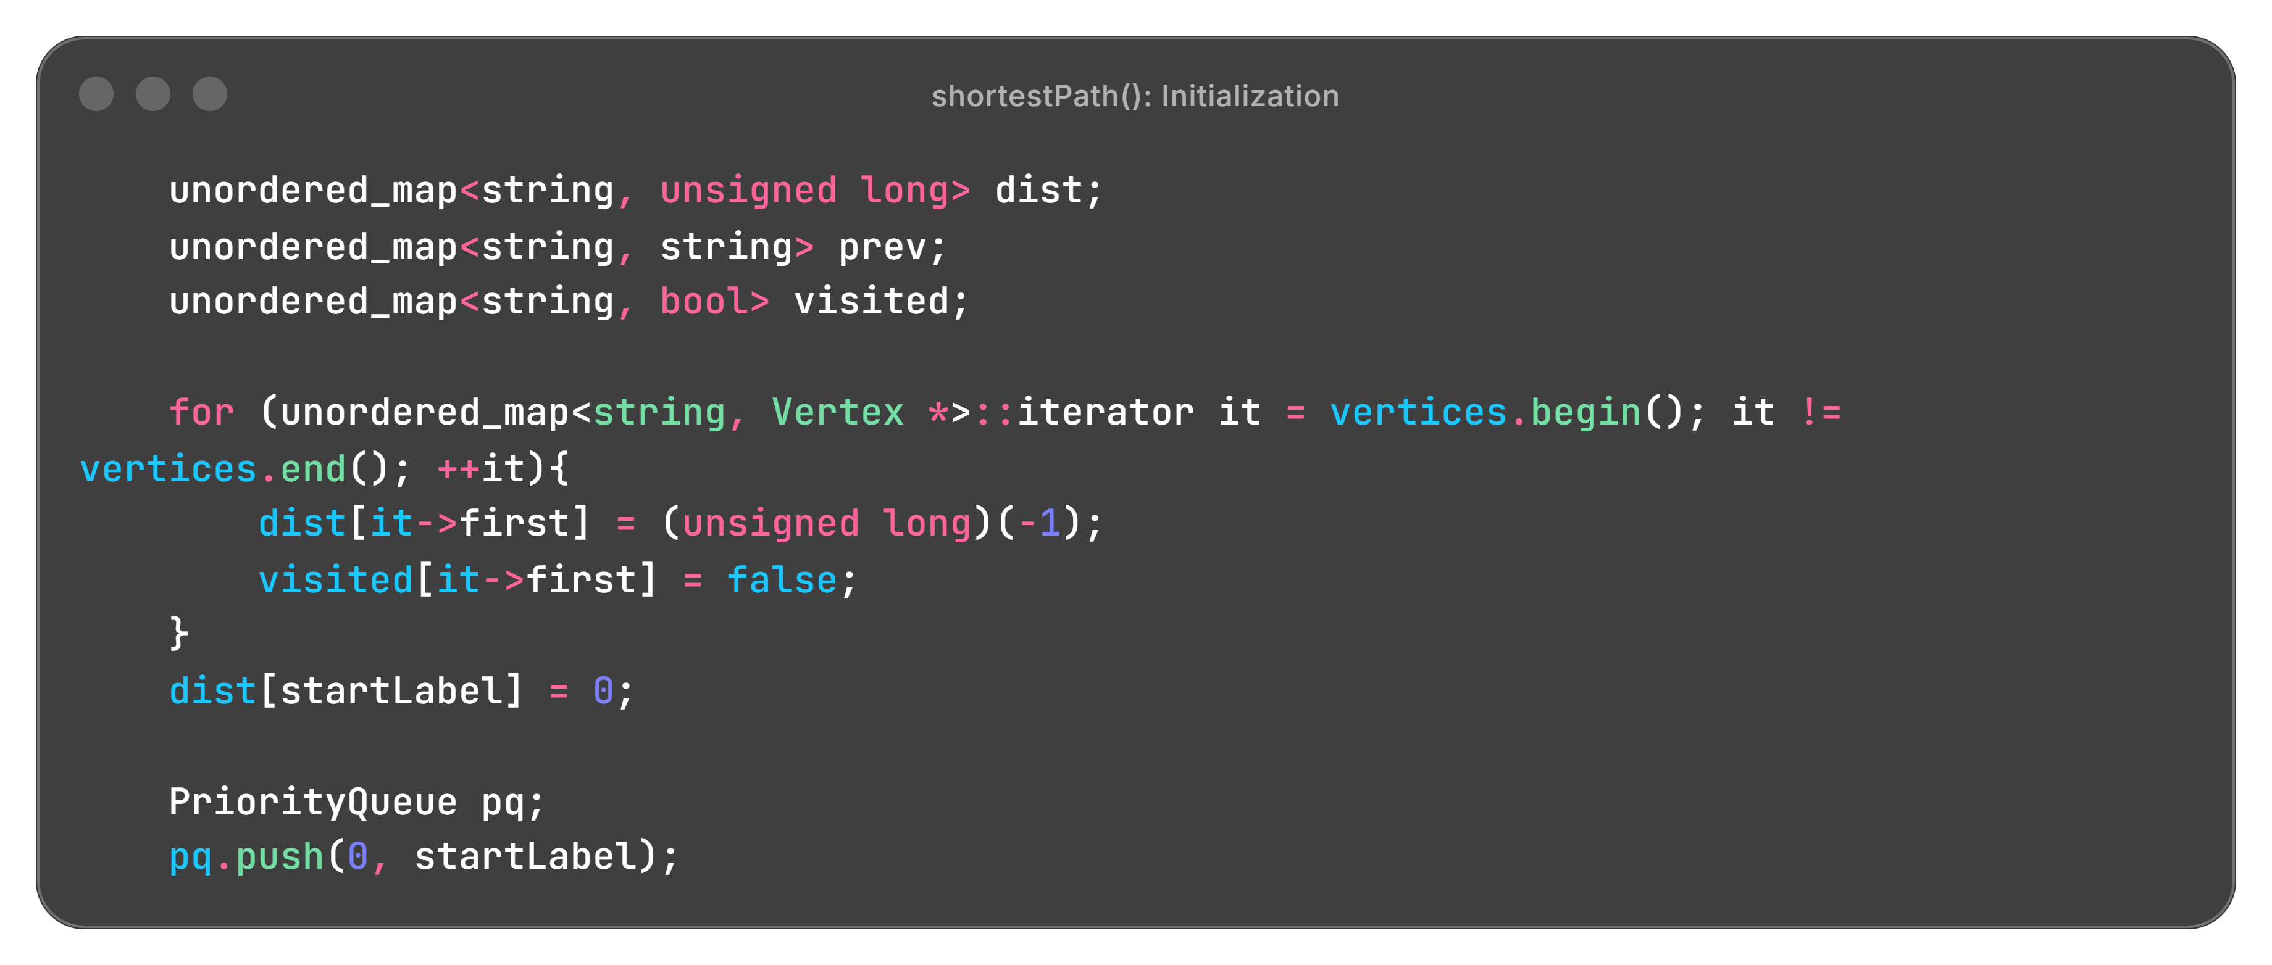
Initialization
Use an iterator to traverse the list and make distances infinity and visited false
Set the start to 0
Set up priority queue by pushing the start onto it as the first vertex

Slide 20
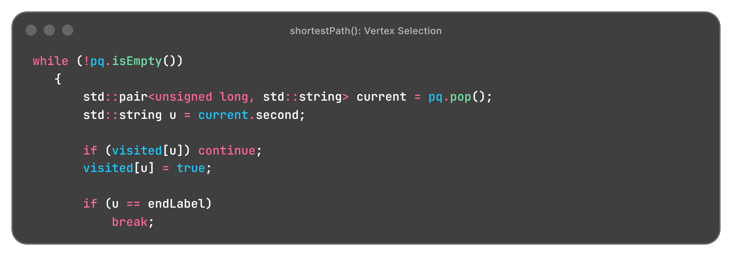
Main Loop: Vertex Selection
Find vertex with smallest distance
If we have already processed this vertex, skip it
Then, mark node as processed
Once vertex is at the end, loop breaks

Slide 21
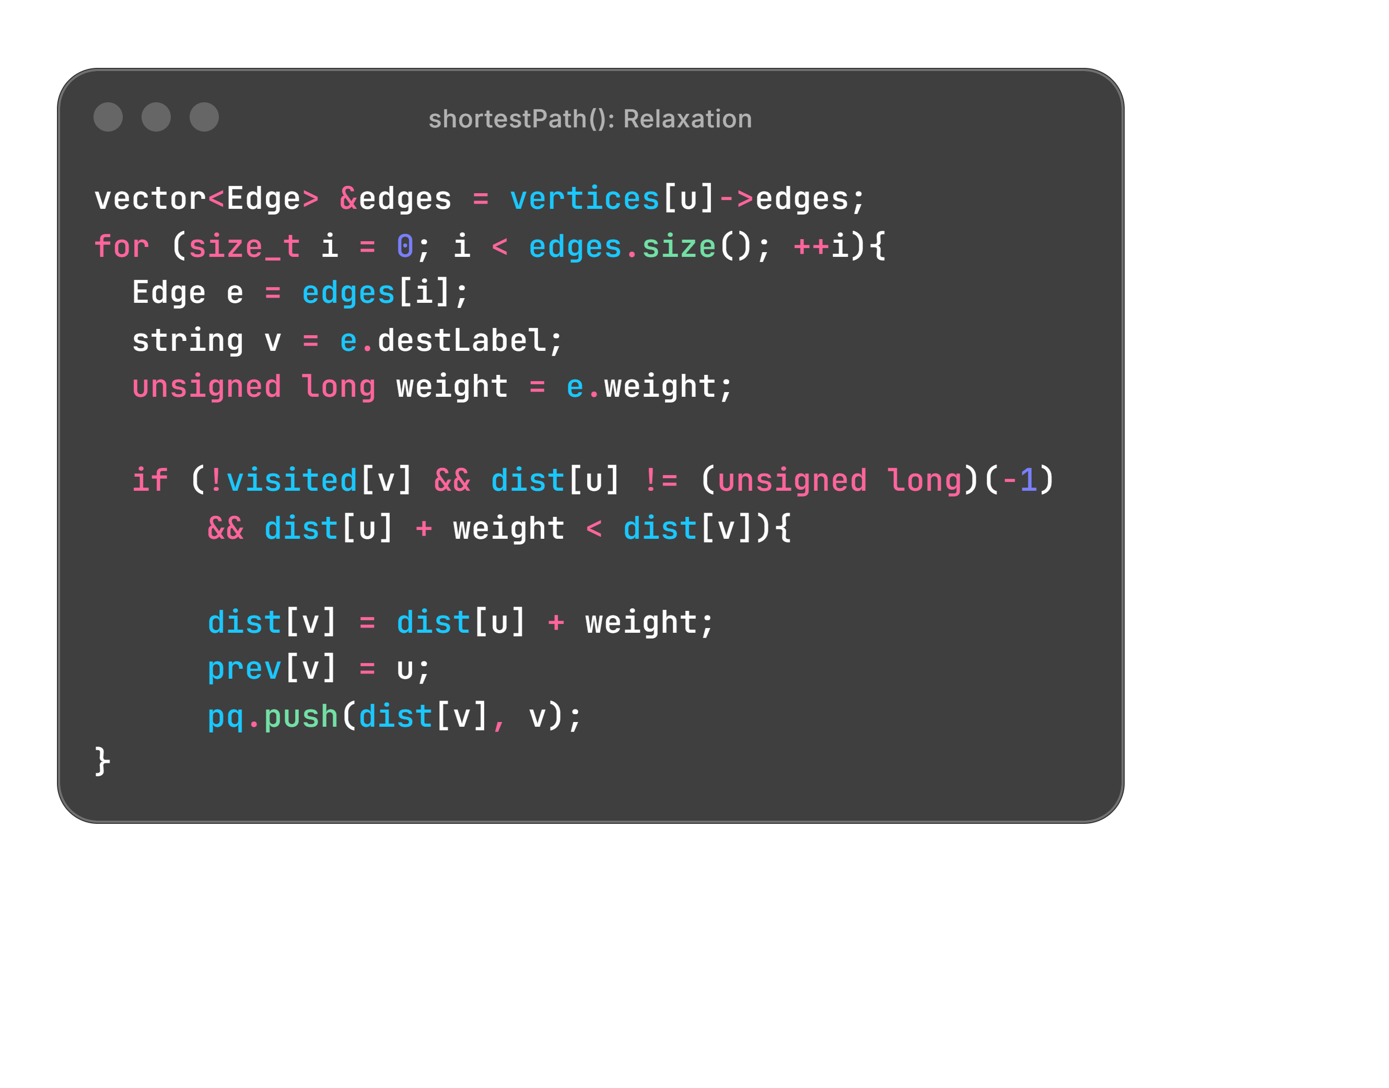
Main Loop: Relaxation
Get the neighbors of vertex u, and for each one ensure that:
dist[u] + weight < dist[v]
If true, update the shortest path, track it, and add the neighbor to the queue

Slide 22
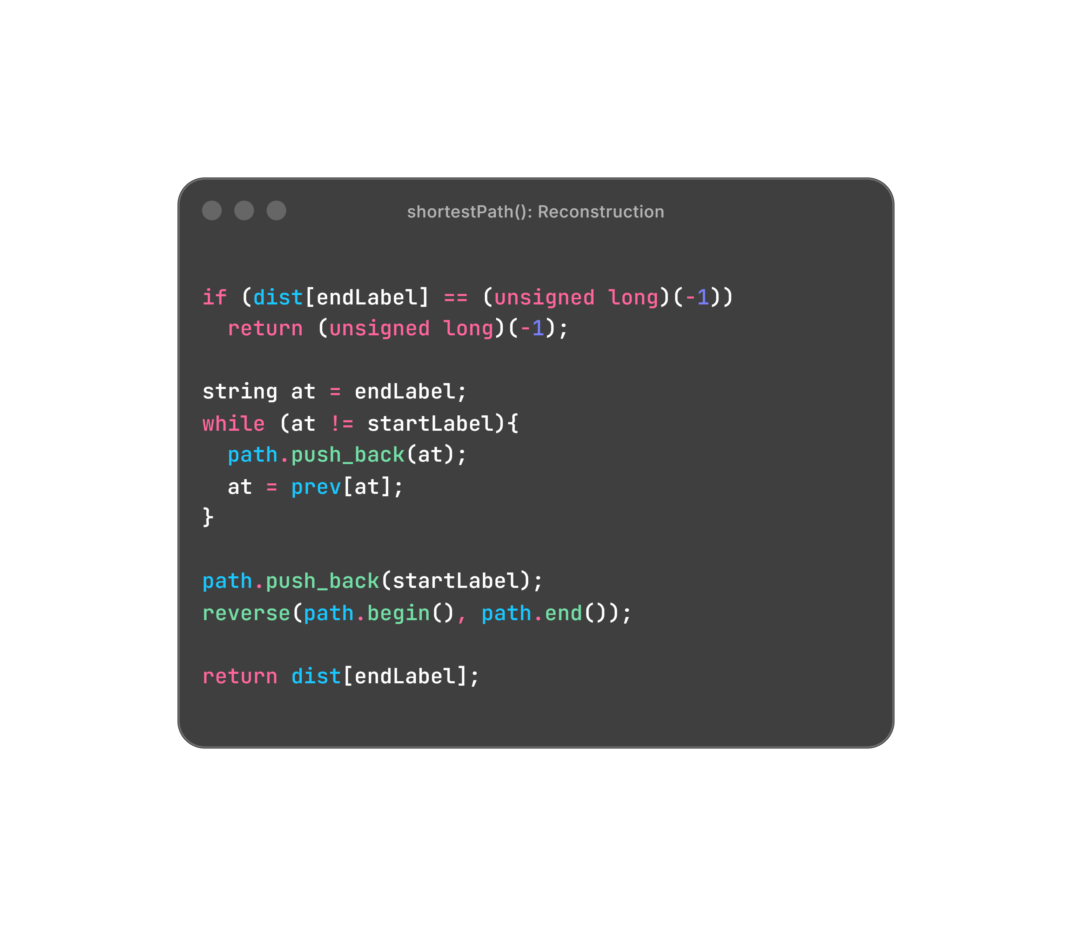
Reconstruction
The algorithm traces back to find the shortest path, then reverses it to get the normal start-to-end structure
In our last example:
Vertex E’s previous is D
Vertex D’s previous is A
Final path: A -> D -> E

Slide 23
Demo

Slide 24
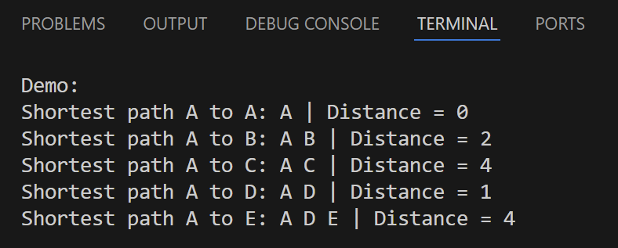
Sample Output
A
2
B
9
E
1
7
4
3
C
D
5
1. 2. 3. 4.
A
2
B
A
A
A
E
1
1
4
3
C
D
D

